Slide 1
REVASCULARISATION IN RENAL ARTERY STENOSIS
- A REVIEW

Slide 2
Why/when/whom should we attempt to revascularise RAS
What is the best mode of revascularisation?
Predictors of favourable outcomes?
Procedural success and complications
Revascularisation in FMD
Guidelines

Slide 3
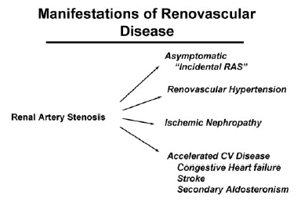
Manifestations of RAS

Slide 4
Causes of RAS
ATHEROSCLEROTIC RENAL ARTERY STENOSIS (ARAS) – 90% OF RAS ABOVE 40 YRS OF AGE
FIBROMUSCULAR DYSPLASIA
NEPHRANGIOSCLEROSIS
AORTORENAL DISSECTION
ATHEROEMBOLIC RENAL DISEASE
RENAL ARTERY VASCULITIS
TRAUMA
EXTRINSIC COMPRESSION
SCLERODERMA
NEUROFIBROMATOSIS
DIABETIC NEPHROPATHY

Slide 5
Prevalence of RAS
Population-based studies -- Among a free-living community RAS above 60% (by ultrasound) in 6.8% of individuals > 65 years
Screening for renal artery disease in subjects with CAD or PVD and HTN yields prevalence of RAS between 18–40%
Affect between 1% and 5% of patients with hypertension
Derkx FH, Schalekamp MA. Renal artery stenosis and hypertension. Lancet. 1994; 344: 237–239
Hypertension and decreased eGFR are nearly ubiquitous in this population

Slide 6
Does RAS need intervention?
The case favoring renal artery stenting for individuals with renal artery hypertension is largely circumstantial
The argument has 3 principal components:
  Observations about the impact on cardiovascular physiology
  End-organ effects and
  Natural history

Slide 7
Natural history
Progressive narrowing of the stenotic diameter of about 5% per year - 56-month follow-up period of untreated patients
Tollefson DFJ et al., Natural history of atherosclerotic renal artery stenosis associated with aortic disease. J VASC SURG 1991;14:327-31.
The progression occurs often rapidly most likely because of plaque rupture or subintimal bleeding
Stewart BH et al. Correlation of angiography and natural history evaluation of patients with renovascular hypertension. J Urol 1970;104:231-8.
Progression occurred in half of the patients without clinical symptoms or signs

Slide 8
Natural history
Thus treatment with potent antihypertensive drugs may mask the progression of the ARAS -- leading to a risk of loss of renal parenchyma
The rapid and unpredictable progression also affects the contralateral side
De novo contralateral development of stenosis has been reported in 17% of cases in 28 months and in 27% in 56 months
Dean RH et al. Renovascular hypertension: anatomic and renal function changes during drug therapy. Arch Surg 1981;116:1408-15

Slide 9
RAS and Kidney Function
The role of atherosclerotic RAS in the genesis of renal dysfunction is controversial
RAS is associated with loss of renal size and function
Schreiber MJ et al., The natural history of atherosclerotic and fibrous renal artery disease. Urol Clin North Am. 1984;11: 383–392.
In patients with significant (60%) RAS, 1 of 4 ipsilateral kidneys demonstrates atrophy of 1 cm in length
Caps MT et al., Risk of atrophy in kidneys with atherosclerotic renal artery stenosis. Kidney Int 1998;53:735–742.
RVD is the suspected cause in 10% to 20% of incident cases of dialysis-dependence among individuals aged 50 years
Appel RG et al., Renovascular disease in older patients beginning renal replacement therapy. Kidney Int 1995; 48:171-6.

Slide 10
RAS and Kidney Function
Up to 27% of those with RAS develop chronic renal failure within 6 years
Wollenweber J, Sheps SG, Davis GD. Clinical course of atherosclerotic renovascular disease. Am J Cardiol. 1968;21:60 –71.
Renal artery revascularization is associated with stabilization or improvement in renal function
Watson PS et al. Effect of renal artery stenting on renal function and size in patients with atherosclerotic renovascular disease. Circulation. 2000;102:1671–1677.
Majority of patients experience stabilization of renal function but a relatively low incidence (15–30%) of improvement in renal function
Zeller T et al. Stent supported angioplasty of severe atherosclerotic renal artery stenosis preserves renal function and improves blood pressure control. J Endovasc Ther 2004; 11: 95–106.

Slide 11
RAS and Kidney Function
Unable to demonstrate a relationship between stenosis severity and renal function
Suresh M et al., Relationship of renal dysfunction to proximal arterial disease severity in atherosclerotic renovascular disease. Nephrol Dial Transplant. 2000;15:631– 636.
Factors beyond percent stenosis that influence function
  Intrinsic to RAS
    Duration of the insult, atheroemboli, hypertensive nephrosclerosis of the contralateral kidney, activation of the RAAS
  Extrinsic factors
    Essential hypertension, DM, concomitant medications, generalized atherosclerosis progression and aging

Slide 12
RAS and Cardiovascular Events
Substantial risk of cardiovascular morbidity and mortality in patients with RAS
6-year cardiovascular event–free survival of 53% with risk related to the severity of the renal stenosis
Wollenweber J et al., Clinical course of atherosclerotic renovascular disease. Am J Cardiol. 1968;21:60 –71.
A significant decrease in 4-year survival was seen in patients with incidental RAS undergoing CAG
Conlon PJ et al., Severity of renal vascular disease predicts mortality in patients undergoing coronary angiography. Kidney Int. 2001;60:1490 –1497
Adverse cardiovascular events occur in excess of the severity of HTN
Blood pressure control may be a poor surrogate for clinical outcomes

Slide 13
RAS and Cardiovascular Events
Mechanism
  ? Effects of renal ischemia and subsequent neuroendocrine activation
  ?simply a marker for advanced atherosclerosis and cardiovascular risk
Angiotensin II
  Smooth muscle proliferation, plaque rupture, endothelial dysfunction and inhibition of fibrinolysis
  Promotes medial and cardiac myocyte hypertrophy(even when BP is controlled)
Aldosterone
  Extracellular matrix and collagen deposition and therefore to myocardial fibrosis

Slide 14
RAS Revascularisation
Early 1980s -- Revascularization of the stenotic atherosclerotic renal artery will salvage the ischemic kidney and will cure hypertension
Novick Ac et al., Revascularization for preservation of renal function in patients with atherosclerotic renovascular disease. J Urol 1983; 129 (5): 907-12.
1990s - the procedure became broadly applied → mixed results emerged
Some patients showed major benefit after PTRA, while others experienced further deterioration of renal function and major morbidity
Textor SC et al., Renal artery stenosis: a 14. common, treatable cause of renal failure? Annu Rev Med 2001; 52: 421-42.

Slide 15
RAS Revascularisation
Open surgical revascularization
  Stabilize or improve renal function in the majority of patients
  Associated with a significant peri-operative morbidity and mortality
Marone LK et al. Preservation of renal function with surgical revascularization in patients with atherosclerotic renovascular disease. J Vasc Surg 2004; 39: 322–329.
The in-hospital mortality for RABG (6608 patients were analysed) was 10.0%
Operative mortality for renal artery bypass in the United States: Results from the National Inpatient Sample J Vasc Surg 2008;48:317-22

Slide 16
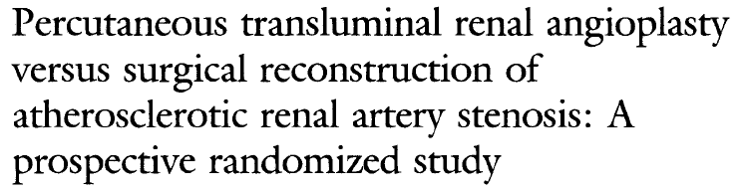
To compare
  Technical success
  Primary and secondary patency
  Effects on bp and renal function after initial treatment with PTRA or operation
In patients with HTN with unilateral ARAS
J VASC SURG 1993

Slide 17
PTRA Vs SURGERY
 | PTRA (%) | SURGERY (%)
TECHNICAL SUCCESS | 83 | 97
PRIMARY PATENCY RATE (24months) | 75 | 96
SECONDARY PATENCY RATE | 90 | 97
HTN IMPROVED | 90 | 86
RFT STABILISED | 83 | 72
Conclusion
  PTRA is recommended as first choice of therapy for ARAS causing renovascular HTN

Slide 18
ARAS --- Reflects the severity and the extension of general atherosclerosis
Associated with atherosclerotic risk factors and target organ damage
Textor SC. Ischemic nephropathy: where are we now? J Am Soc Nephrol 2004; 15 (8): 1974-82.
Patients with severe ARAS are usually older and have comorbid conditions
Hackam DG et al., Role of renin-angiotensin system blockade in atherosclerotic renal artery stenosis and renovascular hypertension. Hypertension 2007; 50 (6): 998-1003.
Mortality is mostly related to cardiovascular events regardless of whether renal revascularization was performed
Conlon PJ et al., Severity of renal vascular disease predicts mortality in patients undergoing coronary angiography. Kidney Int 2001; 60 (4): 1490-7.

Slide 19
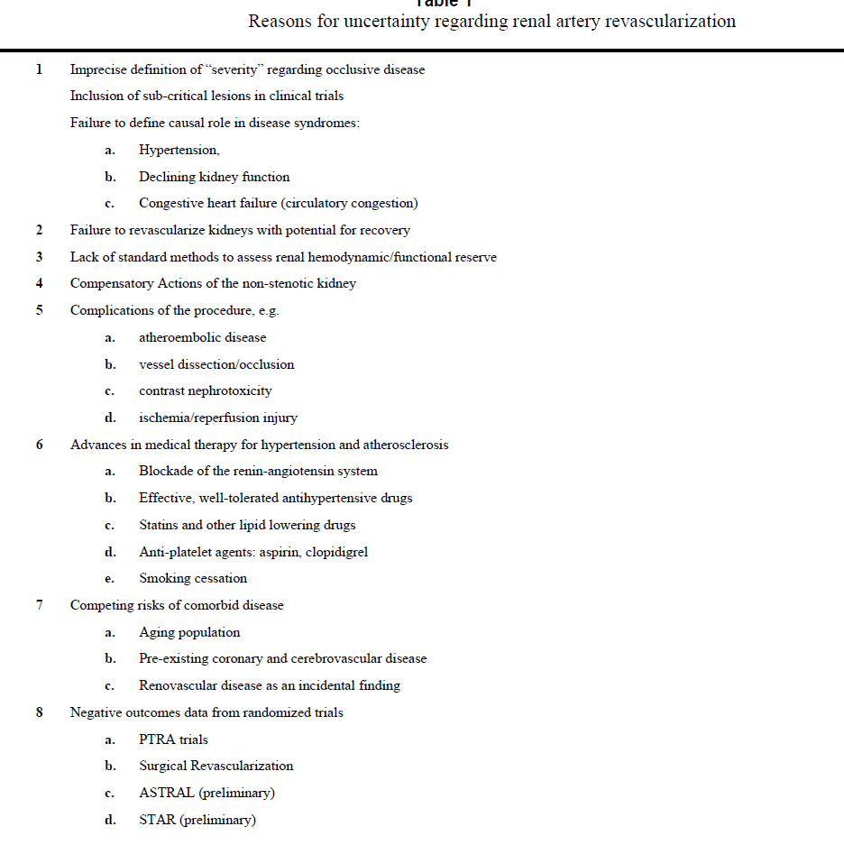

Slide 20
Randomised comparison of percutaneous angioplasty vs continued medical therapy for hypertensive patients with atheromatous renal artery stenosis. Scottish and Newcastle Renal Artery Stenosis Collaborative Group.
Randomised prospective trial
Compared the effects on BP and renal function of PTRA vs medical therapy in hypertensive patients with both unilateral and bilateral disease
METHODS:
55 /135 (44%) were randomised
Eligible patients had sustained HTN with a minimum DBP of 95 mm Hg on at least two anti-hypertensive drugs
RAS was defined by renal angiography as ≥ 50% stenosis
Initial 4-week run-in period on a fixed drug regimen

Slide 21
RESULTS:
In bilateral RAS -- a statistically significant (P<0.05) fall in BP was observed at follow-up (range 3-54 months)
  The mean fall in BP corrected for the medical group response was 26/10 mm Hg
In unilateral RAS, no statistically significant differences in outcome were observed between the two groups
No significant differences in serum creatinine
Major outcome events (death, MI, heart failure, stroke, dialysis) were similar during follow-up
In the 40/135 patients undergoing angioplasty, serious complications attributable to the procedure were observed in 11 patients, bleeding at the arterial site (8 patients) being the most frequent

Slide 22
CONCLUSIONS:
In hypertensive patients with ARAS, PTRA results in a modest improvement in systolic BP compared with medical therapy alone
This benefit was confined to patients with bilateral disease
No patient was 'cured', renal function did not improve and intervention was accompanied by a significant complication rate

Slide 23
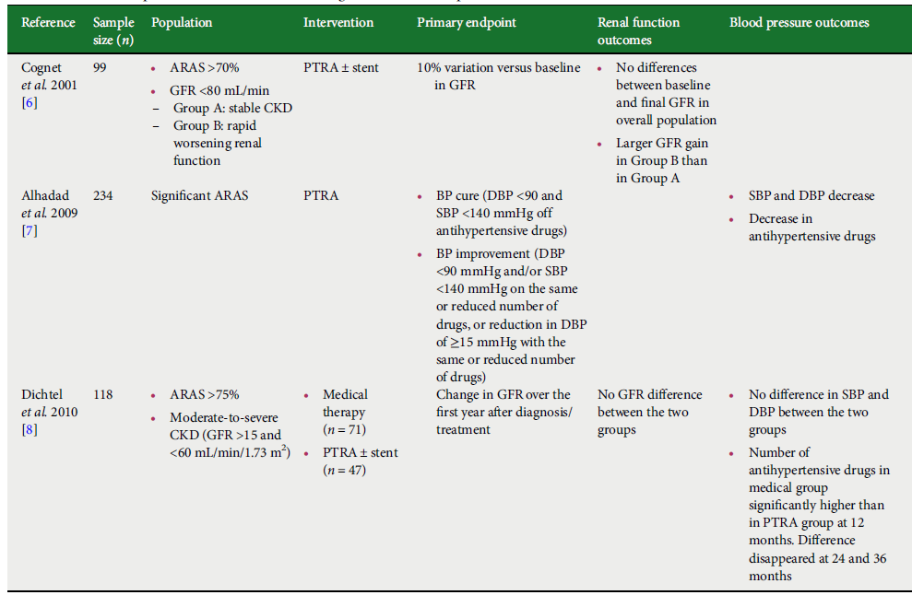

Slide 24
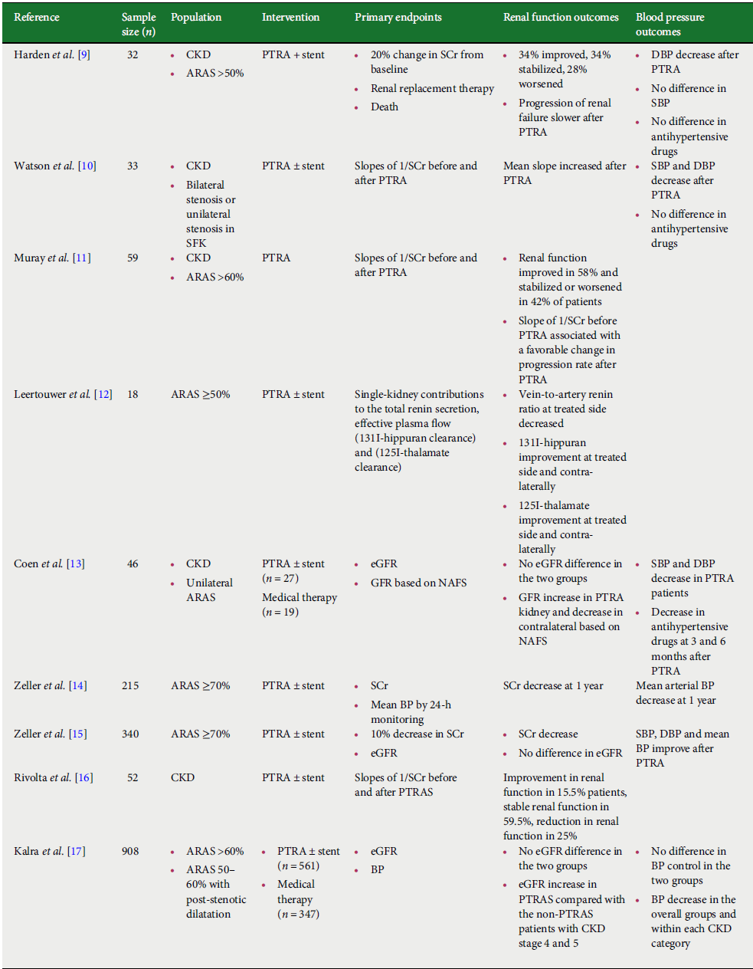

Slide 25
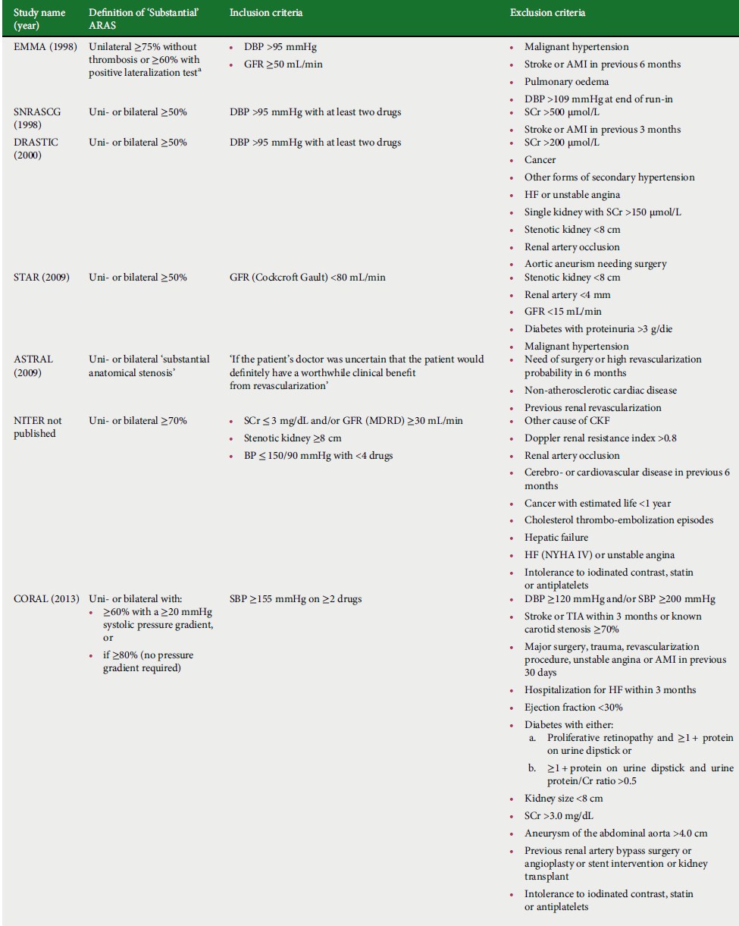

Slide 26
Commonly cited indications for intervention in renal artery stenosis
INDICATION | SUPPORT IN THE LITERATURE
Hypertension resistant to three drugs, including a diuretic | Subgroup analysis of a randomized controlled trial
Recurrent flash pulmonary edema | Retrospective
Acute kidney injury after introduction of a renin-angiotensin system inhibitor | Retrospective
Rapidly declining renal function | Not supported by subgroup analysis from randomized controlled trials
New onset or worsening control of hypertension in older patients | Retrospective

Slide 27
Issues central to Determining Role for Renal Revascularization in Atherosclerotic Renal Artery Stenosis
Questions | Tools for Evaluation
Severity of vascular occlusion? | Quantitative angiography, Translesional gradients, IVUS, Doppler
Treatable? | vessel location, associated disease, accessory vessels, aneurysm, occlusion
Responsible for Disease? | evident activation of pressor systems, e.g. renin -Duration of change, e.g. BP, renal function
Benefit from Revascularization? | Rapidity of evolution, pre-existing injury (e.g. HTN, DM, other kidney disease), associated procedural risk to kidney (e.g. atheroembolic potential), response to OMT Risk of disease progression, salvageability of kidney function (resistive index)

Slide 28
Stenting usually improves flash pulmonary edema
Acute pulmonary edema in the setting of bilateral RAS - improvement in clinical status can be expected in most patients after intervention
Blood pressure improves in 94% to 100%
Messina LM, et al. Renal revascularization for recurrent pulmonary edema in patients with poorly controlled hypertension and renal insufficiency: a distinct subgroup of patients with arteriosclerotic renal artery occlusive disease. J Vasc Surg 1992; 15:73–80
Renal function either improves or stabilizes in 77% to 91%
Pulmonary edema resolves without recurrence in 77% to 100%
Gray BH, et al. Clinical benefit of renal artery angioplasty with stenting for the control of recurrent and refractory congestive heart failure. Vasc Med 2002; 7:275–279.

Slide 29

FEB 2015
Prospective, longitudinal observational study at a single centre
RAS >50% (CT, MR or angiography)
Endpoints
  all-cause mortality
  hospital admission for heart failure
611 patients (152 [25%] with and 459 [75%] without heart failure
87 without HF and 47 with HF were revascularised
Mean follow-up - 4・3 years
 | HEART FAILURE | NO HEART FAILURE
HR for death (Revas Vs Med) | 0・6 (0・3–0・9, p=0・01) | 0・8 (0・5–1・1, p=0・16)
HR for hospital admission for HF | 0・2 (0・0–1・1, p=0・06) | 0・2 (0・0–1・1, p=0・06)

Slide 30
Major randomized trials
Scottish and Newcastle Renal Artery Stenosis Collaborative Group (SNRASCG)
Essai Multicentrique Medicaments vs Angioplastie (EMMA) Study Group
Dutch Renal Artery Stenosis Intervention Cooperative (DRASTIC) study
STAR TRIAL
ASTRAL TRIAL
CORAL TRIAL

Slide 31
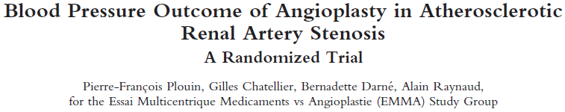
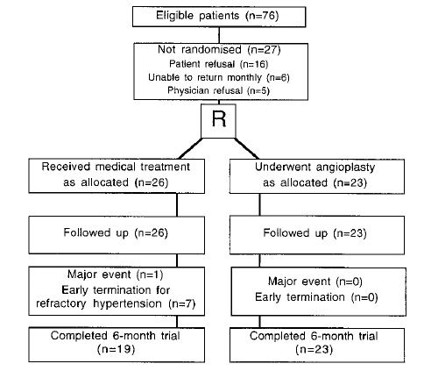
1997
Aim – To document the efficacy and safety of angioplasty for lowering BP
INCLUSION
<75 YRS
Unilateral RAS (≥75% stenosis without thrombosis or 60% with positive lateralisation test)
DBP >95mmHg and on anti HTN drugs
Notes:
In those allocated angioplasty, antihypertensive treatment was discontinued after the procedure but was subsequently resumed if hypertension persisted.

Slide 32
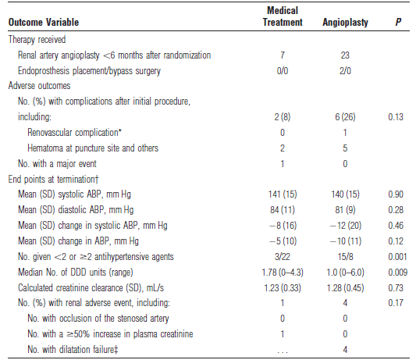
TREATMENT OUTCOMES
Conclusion EMMA
Angioplasty made BP control easier in the short term
More frequently associated with complications
In patients with unilateral atherosclerotic RAS
Draw backs EMMA
Only unilateral RAS was enrolled
Groups were not well balanced - 23 patients for angioplasty and 26 for control
Cross-over of patients
High complication rate in angioplasty group (6 of 23 or 26%)

Slide 33
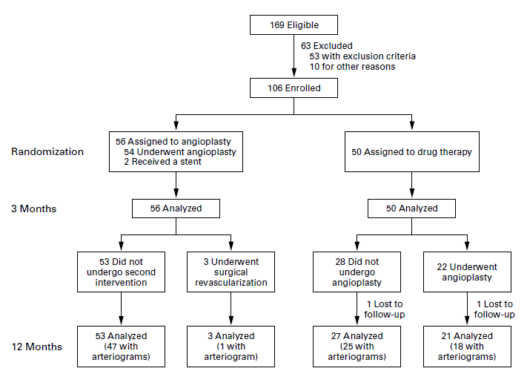
NEJM 2000
INCLUSION
RAS (luminal diameter < 50 %)
Serum creatinine ≤ 2.3 mg/dl
DBP ≥ 95 mm Hg with two antihypertensive drugs

Slide 34
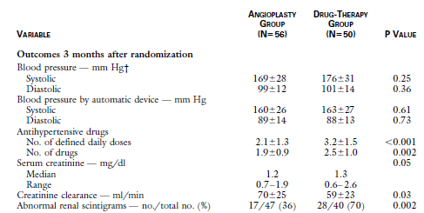
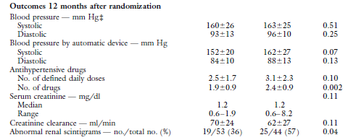
TREATMENT OUTCOMES
Outcomes 3 months after randomization
Outcomes 12 months after randomization
Angio drug p

Slide 35
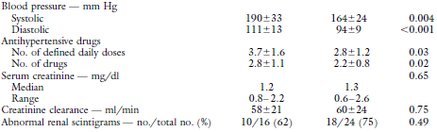
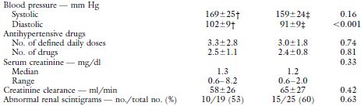
TREATMENT OUTCOMES - SUBGROUP ANALYSIS
LIMITATIONS
Sample size was not sufficient
RAS was defined as greater than 50% stenosis
High rate of cross over - 22/50 patients randomized to medical therapy crossed over to the angioplasty group
Outcomes 3 months after randomization
Outcomes 12 months after randomization

Slide 36
NEW RANDOMIZED TRIALS

Slide 37
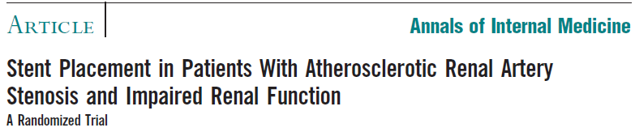
Objective:
To determine the efficacy and safety of stenting in patients with ARAS and impaired renal function
Design: Randomized unblinded clinical trial
Setting: 10 European medical centers
Participants: 140 patients with creatinine clearance < 80mL/min/1.73 m² and ARAS of ≥ 50%

Slide 38
STAR TRIAL
Intervention
Stent placement and medical treatment (64 patients)
Medical treatment only (76 patients)
Medical treatment consisted of antihypertensives, a statin and aspirin
End points
Primary
≥ 20% decrease in creatinine clearance
Secondary
Safety and cardiovascular morbidity and mortality

Slide 39
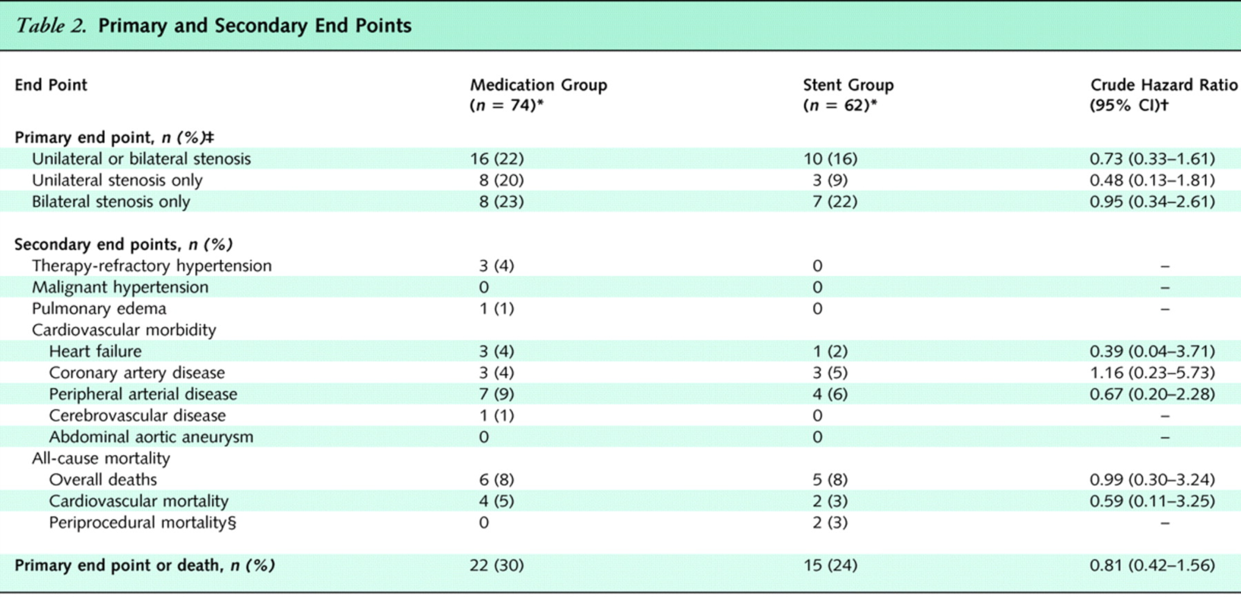

Slide 40
STAR TRIAL
Limitation
Many patients were falsely identified as having RAS >50% by noninvasive imaging and did not ultimately require stenting
Only 46/64 (72%) of the stent group received a stent, 18/64 (28%) did not
More than half of the patients had unilateral disease
Included patients with mild RAS
  33% of the patients - RAS 50%-70%
  12 (19%) intervention group RAS < 50%
Complication rates were high
Conclusion
Stent placement + medical treatment had no clear effect on progression of impaired renal function
Small number of significant procedure-related complications
Conservative approach >> Intervention

Slide 41
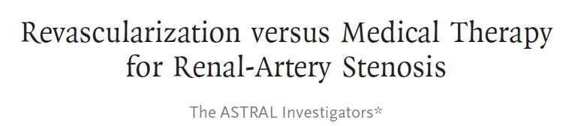
NEJM 2009
Multicenter, randomized, unblinded trial
Patients Enrolled: 806 (1:1 Stratified randomization)
Mean Follow Up: 27 months
Mean Patient Age: 70 years
Female: 37
Primary Endpoint
Change in renal function
Secondary Endpoints:
  Blood pressure control
  Time to first renal event
  Time to first cardiovascular event
  Mortality

Slide 42
Exclusions
Need for surgical revascularization
High likelihood of needing revascularization within 6 months
Nonatheromatous cardiovascular disease
History of prior revascularization for renal artery stenosis

Slide 43
At baseline for the entire group
Serum creatinine - 2.02 mg/dl
Estimated GFR - 40 ml/min
Mean stenosis - 76%
Mean number of antihypertensive - 2.8 per patient
BP - 151/76 mm Hg
53% ex-smokers, 30% diabetics and 41% PVD
6% of the medically treated patients crossed over to revascularization
82% of the revascularization group that were successfully revascularized (95% of revascularized patients ) received a stent

Slide 44
OUTCOMES
OUTCOMES | REVASCULARISATON (%) | MEDICAL (%) | p
Overall mortality | 25.6 | 26.3 | 0.46
CV mortality | 7.4 | 8.2 | NS
Any CV event | 35 | 36 | 0.96
Hospitalization for fluid overload or heart failure | 12 | 14 | NS

Slide 45
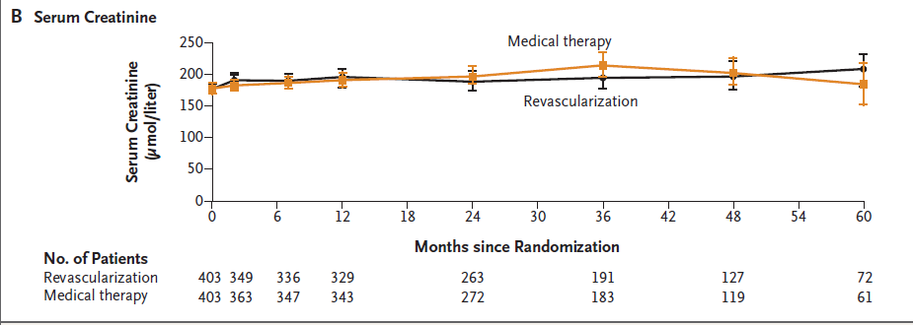
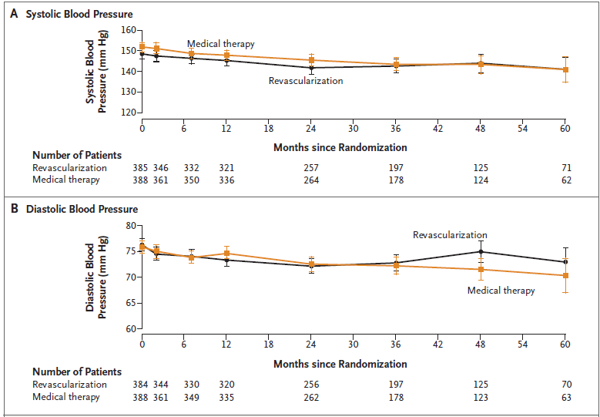
OUTCOMES – RENAL FUNCTION
OUTCOMES – SYSTOLIC AND DIASTOLIC BP

Slide 46
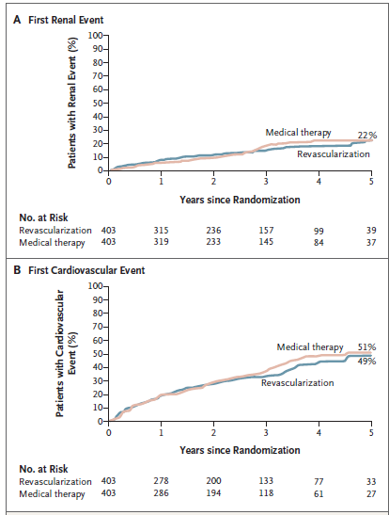
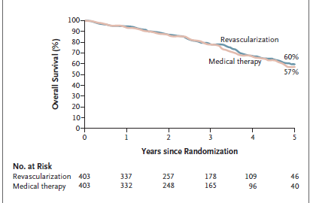
Kaplan–Meier Curves for Overall Survival
Kaplan–Meier Curves for the Time to the First Renal and Cardiovascular Events

Slide 47
Major drawbacks of ASTRAL
Normal renal function at baseline - 25% of patients in each group had normal renal function (eGFR > 50 ml/min/1.73 m2) at the entry of the trial
No core laboratory were found - some patients in the 50%–70% stenosis group actually had a stenosis of < 50%

Slide 48
Possible selection bias - physicians were aware that which patients would benefit from either revascularization or medications
High complication rate - major complication rate in first 24 hrs - 9%
Non-blinding - observer and selection bias – high
Rate of cross-over - 6% from medication to intervention gp

Slide 49
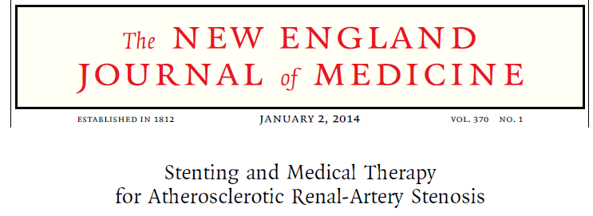
CORAL
CORAL
Open labelled randomized multicenter controlled trial
Randomized 947 participants with ARAS (≥ 60%) and either HTN while taking ≥ 2 antihypertensive drugs or ≥ stage 3 CKD
Primary outcome
Composite of cardiovascular or renal death
MI, stroke
Hospitalization for CHF
Progressive renal insufficiency
Need for RRT

Slide 50
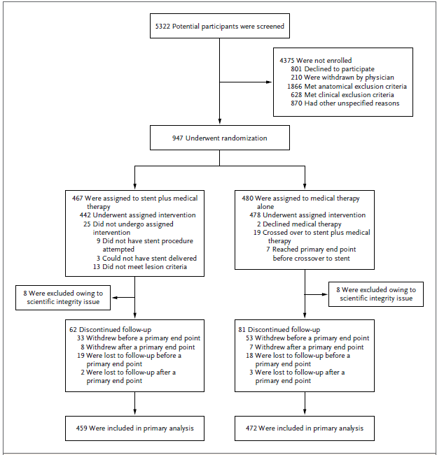

Slide 51
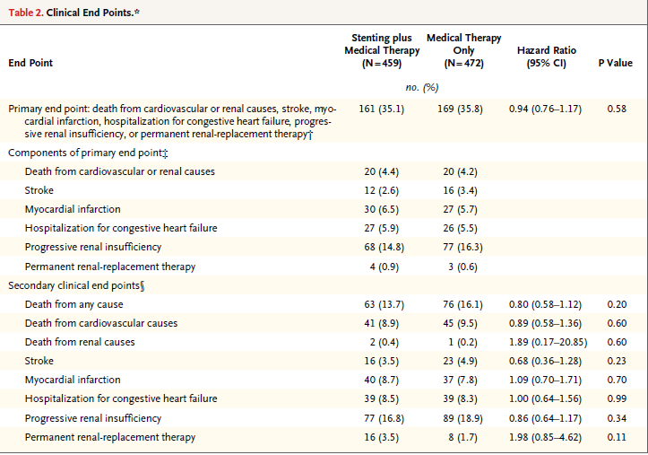
CORAL - RESULTS

Slide 52
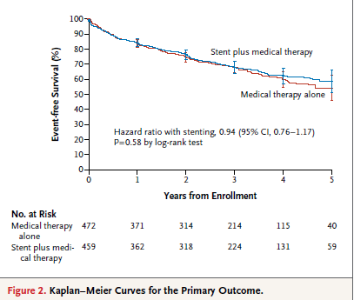
CORAL - RESULTS
No significant differences in the rates of the individual components of the primary end point or in all-cause mortality

Slide 53
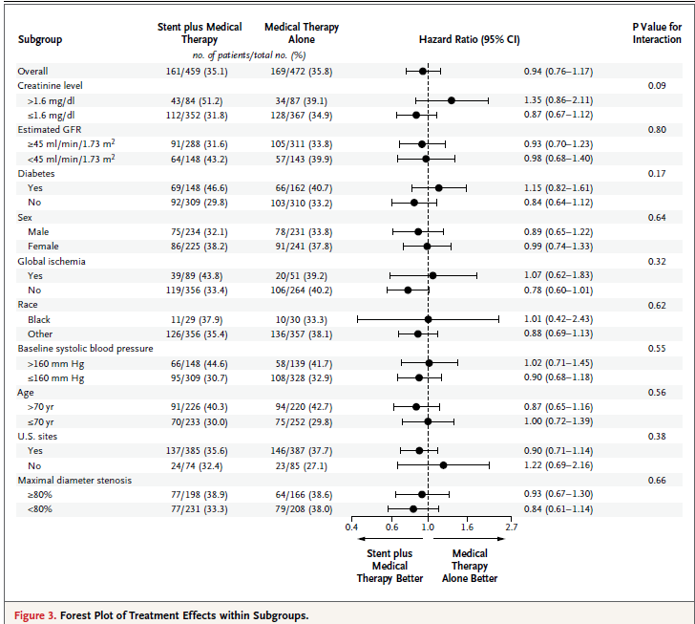
CORAL - RESULTS
Consistent modest difference in systolic BP favoring the stent group (−2.3 mm Hg; 95% CI, −4.4 to −0.2; P = 0.03)

Slide 54
Percutaneous Revascularization for Atherosclerotic RAS
A Meta-Analysis of Randomized Controlled Trials
Seven prospective, randomized, controlled trials
1916 patients (937 with PR, 979 with medication alone
Outcomes analysed:
  Changes in SBP and DBP
  Reduction in antihypertension medication, serum creatinine, worsening renal failure, mortality, stroke and CHF

Slide 55
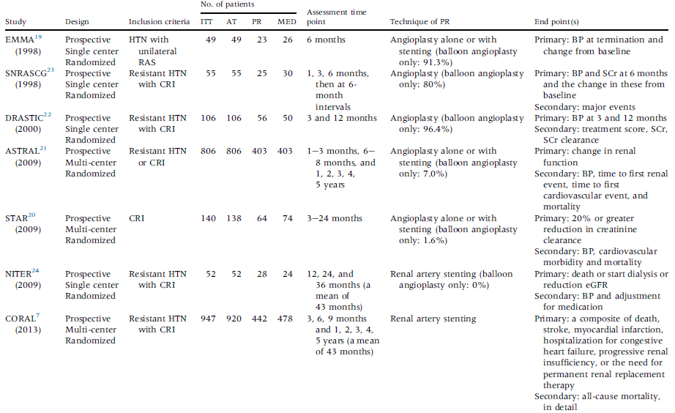
A Meta-Analysis of Randomized Controlled Trials

Slide 56
A Meta-Analysis of Randomized Controlled Trials
The changes in SBP/DBP from baseline were similar between the 2 groups (changes in SBP: P ¼ 0.69; changes in DBP: P ¼ 0.15)
PR treatment led to a statistically significant decrease in the number of antihypertensive medications (SMD 0.18, 95% CI 0.27 to 0.10, P < 0.001)
No significant difference for deteriorating renal function, CHF or stroke
Conclusion: PR is equally effective to medical management in the treatment of RAS

Slide 57
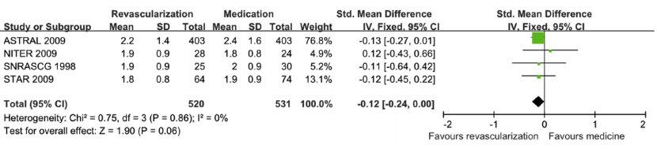
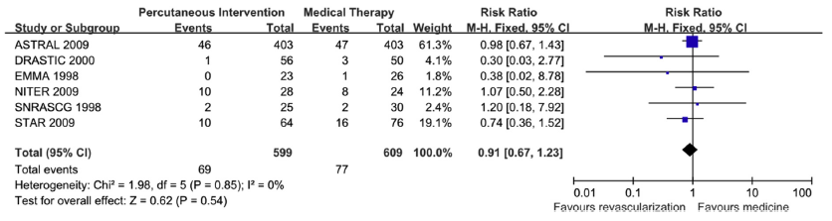
CHANGES IN S.CREATININE
WORSENING RENAL FAILURE

Slide 58
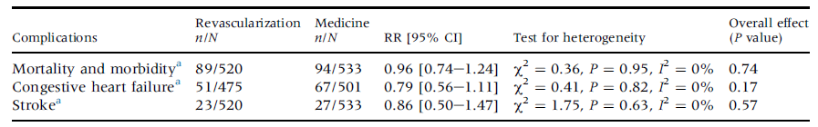
SECONDARY OUTCOME EVENTS

Slide 59
Ongoing trials
Study | Included patients | Treatment | Follow-up | Endpoint
RAVE | 240 | PR + stent vs. best medication | 2 years | Composite of death, dialysis and doubling of SCr
RADAR | 300 | PR + stent + best medication vs. best medication | 36 months | Difference in change of eGFR over 12 months

Slide 60
Why revascularisation doesn’t work for ARAS
Atherosclerosis affects the kidney and its small intra-renal arteries directly
  Irreversible renal damage
Atheromatous embolization - ? major cause of acute decline in renal function
Intervention of lesions without hemodynamic gradients
“competing risk” from other manifestations of atherosclerosis
Renal artery disease primarily reflects the burden of atherosclerotic disease elsewhere
Uzzo RG, Novick AC et al. Medical versus surgical management of atherosclerotic renal artery stenosis. Transplantation Proc 2002;34:723–5.

Slide 61
The principles and success of vascular intervention in the coronary and peripheral arteries may not extend to the renal circulation
Kidneys receive an excess of oxygenated blood, far more than needed for basal metabolic demands
Epstein FH. Oxygen and renal metabolism. Kidney Int 1997;51:381–5.
kidneys can be less susceptible to moderate changes in blood flow in the absence of pre-existing renal disease

Slide 62
Factors predicting outcomes
Non-invasive predictors of a favorable response to revascularization in ischemic nephropathy
  Baseline characteristics
    Mild renal impairment
    Severe RAS
    Non-diabetics
Zeller T et al. Predictors of improved renal function after percutaneous stent-supported angioplasty of severe atherosclerotic ostial renal artery stenosis. Circulation 2003;
Renal renin levels, BNP etc. -- low positive predictive value
The most important predictor
  The rate of decline in renal function before the intervention
Renal RI > 0.8
Patients with a rapid deterioration in renal function experience greater benefit

Slide 63
Technical issues related to renal artery stenting
10–20% of procedure-related deterioration in renal function following renal artery stent revascularization
Kuan Y et al. GFR prediction using the MDRD and Cockcroft and Gault equations in patients with end-stage renal disease. Nephrol Dial Transplant 2005; 20: 2394–2401.
Currently more complex cases can be safely managed without adding much procedural risk
Use of steerable guiding catheters
  Gentle engagement of renal artery ostia
Precise imaging tools
  Adequate lesion coverage and targeted stent extension into the abdominal aorta

Slide 64

32 RA-PTAS procedures performed with DEP (2003 – 2005)
Using a temporary balloon occlusion and aspiration catheter
eGFR was estimated preintervention and 4 to 6 weeks postintervention

Slide 65
DEP during PTRA
HTN – 100%
Renal insufficiency - 92%
Mean preintervention degree of RAS - 79%
100% immediate technical success
Mean pre- and postintervention (6 weeks)
  serum creatinine - 1.9 vs 1.6 mg/dL (P < .001)
  eGFR - 37 vs 43 mL/min/1.73 m2 (P < .001)
Renal function
  Improved - 53%
  worsened - 0

Slide 66
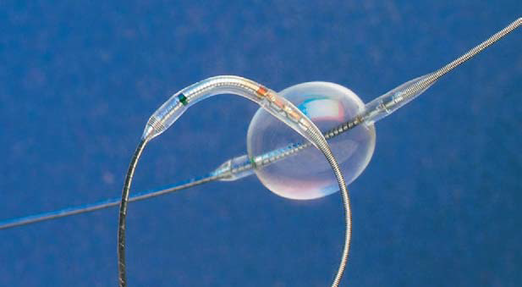
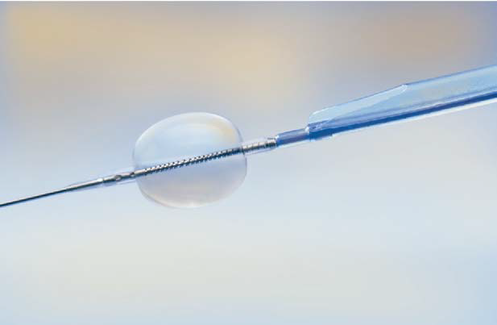
Photograph of the Medtronic Guardwire temporary balloon occlusion distal embolic protection system.
Photograph of the Medtronic Export catheter for aspiration of atheroembolic debris.

Slide 67
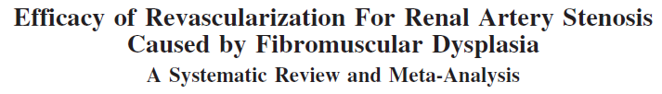
Fibromuscular dysplasia

Slide 68
47 angioplasty studies (1616 patients) and 23 surgery studies (1014 patients)
Angioplasty or surgical revascularization yielded moderate benefits in FMD RAS
The blood pressure outcome was strongly influenced by patient age
 | ANGIOPLASTY | SURGERY
Hypertension cure | 46% (95% CI: 40% to 52%) | 58% (95% CI: 53% to 62%)
<140/90mmHg off drugs | 36% | 54%
Combined periprocedural risk | 12% | 17%
Major complications | 6% | 15%

Slide 69
Special cases – Transplant kidney
TRAS - most frequently in the first 6 months
Transplant recipient with hypertensive crisis and flash pulmonary edema - Pickering Syndrome
Doppler -- screening tool
Angiography -- definitive diagnosis
PTRAS is generally the first-line therapy to correct hemodynamically significant TRAS

Slide 70
Special cases – Transplant kidney
PTRA -- Immediate cure or improvement in 76% of patients (mean follow-up : 30 months)
A retrospective review of 547 renal transplants performed over a 6-year period
Greenstein SM et al. Percutaneous transluminal angioplasty. The procedure of choice in the hypertensive renal allograft recipient with renal artery stenosis. Transplantation 1987
Overall clinical success rate of 76.9% in a 10- year retrospective study
Chew LL et al. Percutaneous transluminalangioplasty of transplant renal artery stenosis. Ann Acad MedSingapore 2014; 43: 39–43

Slide 71
Special cases – Transplant kidney
Revascularization in TRAS reduced BP but no significant change to the GFR
Ruggenenti P et al. Post-transplant renal artery stenosis: the hemodynamic response to revascularization. Kidney Int 2001; 60 (1): 309-18.
No significant improvement in overall allograft survival was observed in 145 of the 823 patients with TRAS who underwent angioplasty (USRDS registry) (P = 0.4)
Hurst FP et al. Incidence, predictors and outcomes of transplant renal artery stenosis after kidney transplantation: analysis of USRDS. Am J Nephrol 2009; 30: 459–467

Slide 72
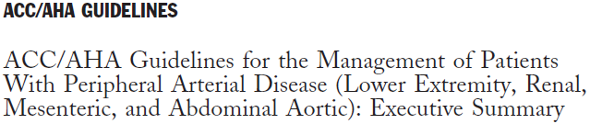
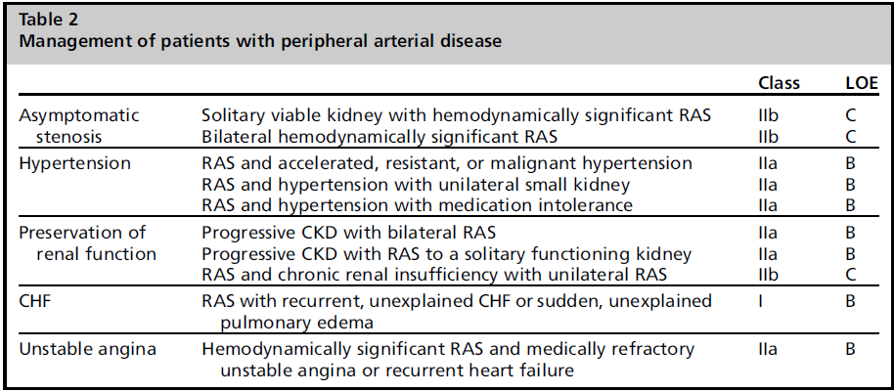
MANAGEMENT OF RAS

Slide 73
Surgery for RAS -- Recommendations
Class I
FMD with indications for interventions, especially those exhibiting complex disease that extends into the segmental arteries and those having macroaneurysms. (LoE: B)
ARAS with clinical indications for intervention, especially those with multiple small renal arteries or early primary branching of the main renal artery (LoE: B)
ARAS in combination with pararenal aortic reconstructions (in treatment of aortic aneurysms or severe aortoiliac occlusive disease). (LoE: C)

Slide 74

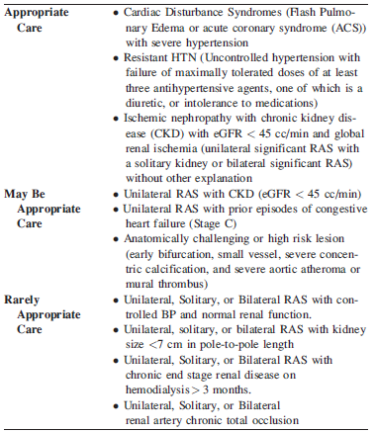

Slide 75
THANK YOU

